Slide 1

DriverPass System Analysis
[Your Name]
Notes:
[No speaker notes required for this slide.]

Slide 2
System Requirements
The user or administrator must be able to set appointments through the phone or online.
The user must be able to view their driving instructor for a specific date.
The user must be able to visually see their progress.
The owner shall be able to download any data for future overview.
Notes:
The website shall allow users and administration to set appointments. The user needs to be able to see who they are going to be training with before they take their lessons. The website will feature a user prompt for their password and username should they be forgotten. Also, There must be a measurement of user progress on the site so the user can see where their weaknesses lie. Or, to see how much longer the training will be before they can successfully pass the drivers exam.

Slide 3

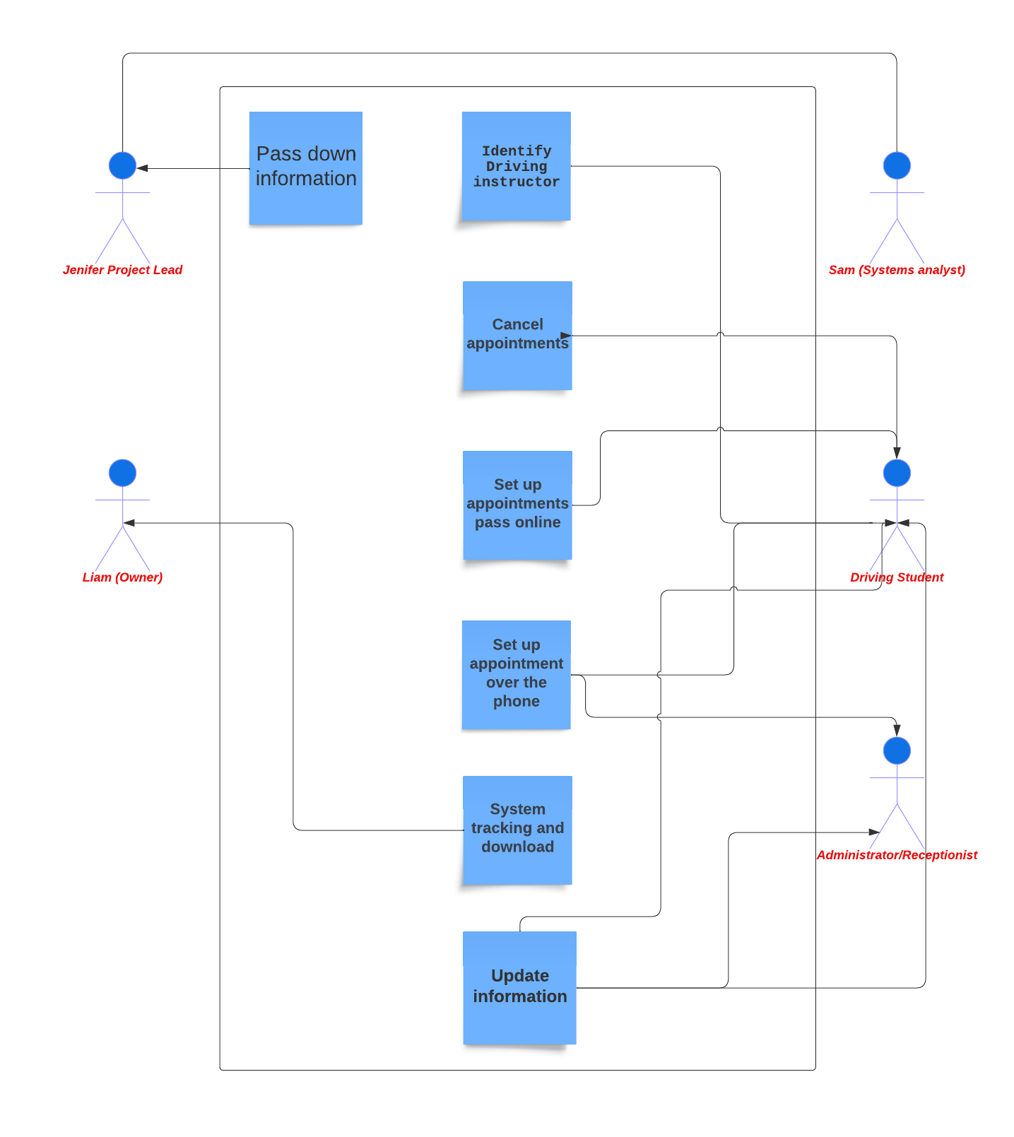
Use Case Diagram
use case diagram here.]
Notes:
The different actors in the diagram are the owner, project lead, analyst, student, and the driving instructor. There are certain processes that need to be “funneled to the correct character to ensure security, and solid communication. ”

Slide 4
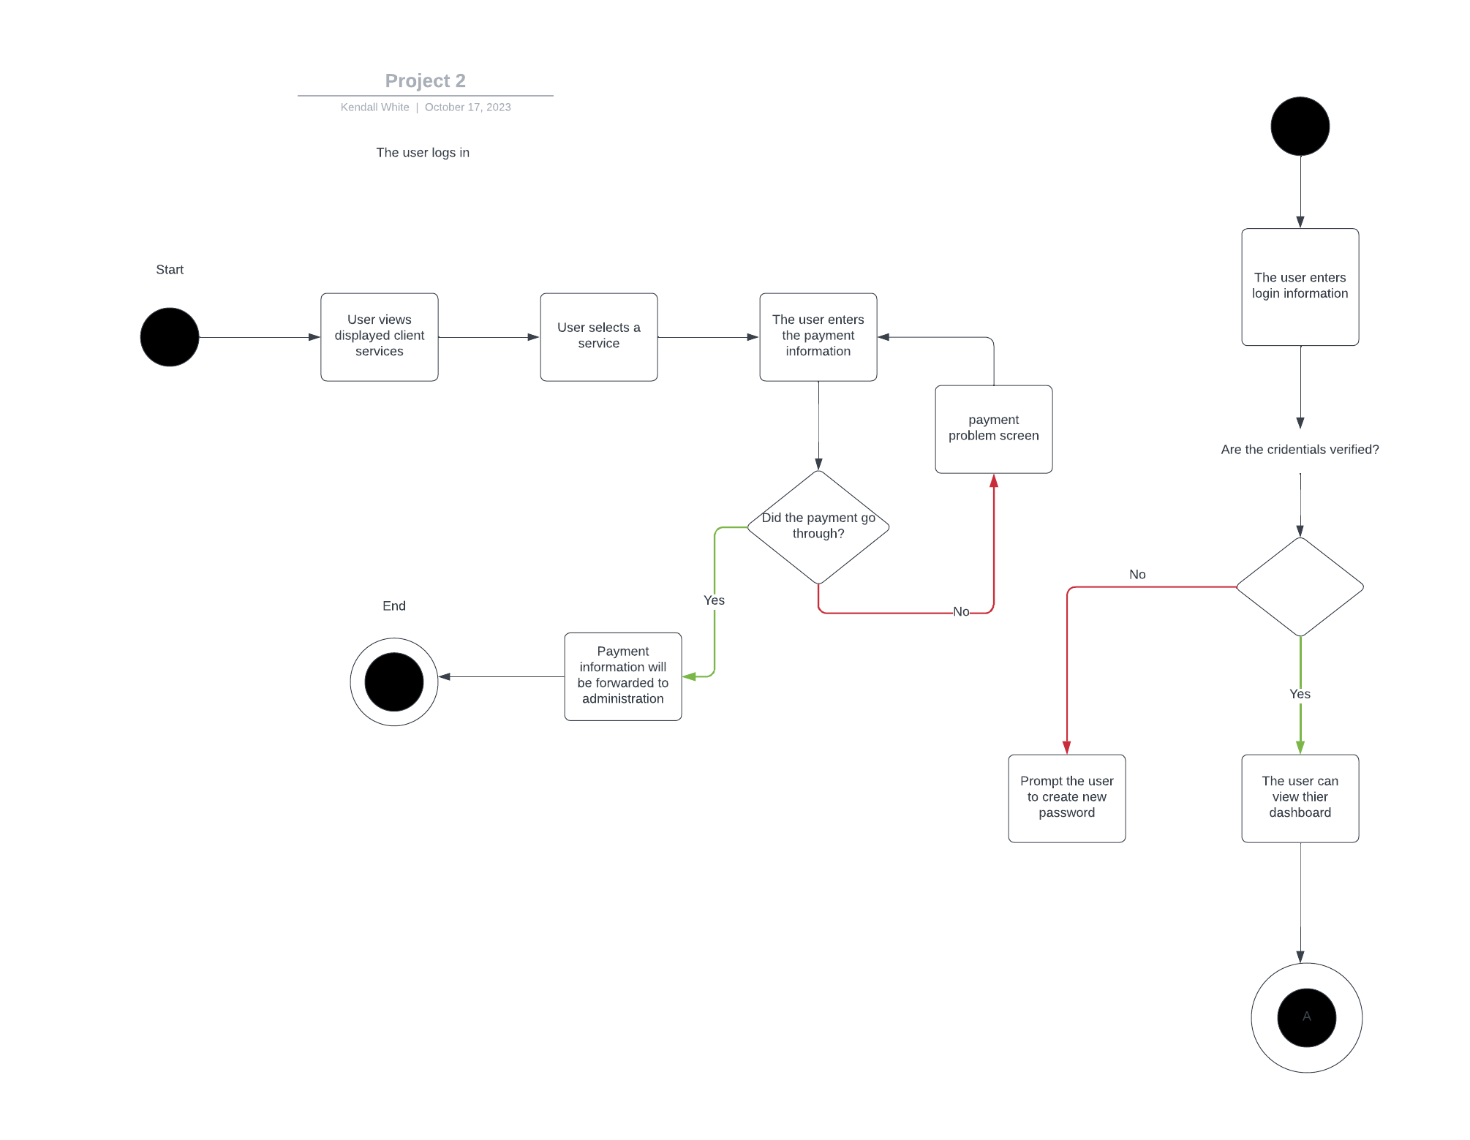
Activity Diagram
Notes:
The diagram expresses the process of how the system works from start to finish. The user will log in contact form on the website. All credentials need to be verified before the process can continue.A service is selected followed by the user entering payment information. If the payment does not go through, they will be rerouted to the payment screen to re enter their payment information. If the user payment is successful, the process is completed.

Slide 5

Security
The user must be able to create a new password if forgotten.
The site will prompt the user to enter their username and password before taking them to the dashboard.
Notes:
How I considered security within the system was to keep the user and customer in mind. It was important to ensure personal information would be kept safely on file. Should a situation occur where the user cannot log back in. There will be a part of the process that covers this. This also ensures no one else but the user can have access to the account of the user.

Slide 6
System Limitations
Only the user, owner, and administrator can view personal information of the user.
After a driving instructor is booked for an appointment. There may need to be a replacement if they take off. This may leave minimal driving instructors to fill in for the original instructor.
Notes:
With the constraints in the system, there are only certain individual that can view personal information that have correct access rights. It is important to include the admin to be able to book appointments like the users will. In case an instructor cannot make it. We would need an employee with access rights to re book appointments for the future.

